Slide 1
Machine Learning on Kubernetes​
A modern approach

Slide 2






Introduction: Machine Learning and Kubernetes
Machine Learning is gaining massive popularity in research and economy
Popular tools and frameworks: Python, Slurm, PyTorch, Kubernetes, Kubeflow, Keras, Tensorflow, Sklearn…..
Challenges:
Handling dev resources
QA and rollout
Scientific issues (model limitations)
Rollout Scaling

Slide 3
Introduction: Machine Learning and Kubernetes
What will we learn today?
How to plan and run a typical ML (Machine Learning) experiment
Core concepts of ML projects (Model training, Data Munging, Cross Validation..)
Leveraging Kubernete‘s power to easily distribute our computational heavy-lifting
How to bring our model to production.
How to maintain and version data and saved models.

Slide 4
Kubernetes???
Container orchestration software that is widely used to deploy applications
Active Users include: Google, Netflix, Amazon, Niantic… and even the American Airforce
Kubernetes helps us to spin up containers and administrate their lifecycle
By using Kubernetes we can easylie abstract our infrastructure from the actual hardware
Main advantage: Easy (and automatic) scaling of resources

Slide 5
Kubernetes! …And ML??
ML is challenging!
Typically resources of a cluster need to be shared between engineers/scientists
Also ML services tend to be hungry for updates and prone to develop unexpected behaviour
Kubernetes helps us to strip away the trouble of sharing resources and auto-deploying ML services

Slide 6
Kubernetes
Basic Concepts

Slide 7
Overview
Basic components that we will cover:
Containers (here: maintained with the Dockerdeamon)
Pods
ReplicaSets
Deployments
VolumeMounts and Secrets
Existient but off scope:
CronJobs (as in any unixoid system)
DeamonSets
Custom Resources

Slide 8
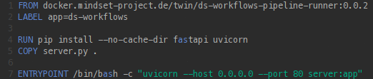
Containers: The smallest unit
A container is a very slim operating system (without visualization and init system)
Containers live in an isolated space on a Host System (in Kubernetes: A Node)
Here: defined and built via Docker

Slide 9
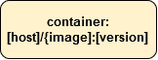
Containers: The smallest unit

Slide 10
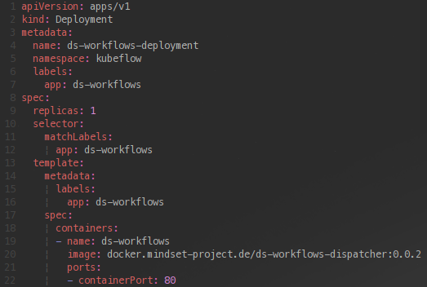
Pods: Grouping things
Pods are used to group containers that logically belong together
Pod containers share their ports (!!)
Per default any Pod can run on any Node
Can be marked with labels, accessed via SSH, and bound to certain Nodes

Slide 11
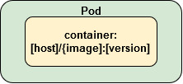
Pods: Grouping things

Slide 12
ReplicaSets: Keep it alive
A container is a very slim operating system (without visualization and init system)
Containers live in an isolated space on a Host System (in Kubernetes: A Node)
Here: defined and built via Docker

Slide 13
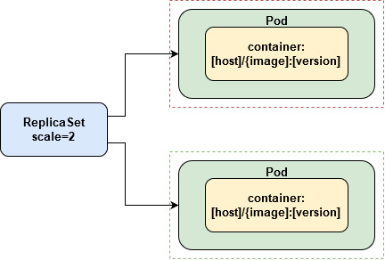
ReplicaSets: Keep it alive

Slide 14
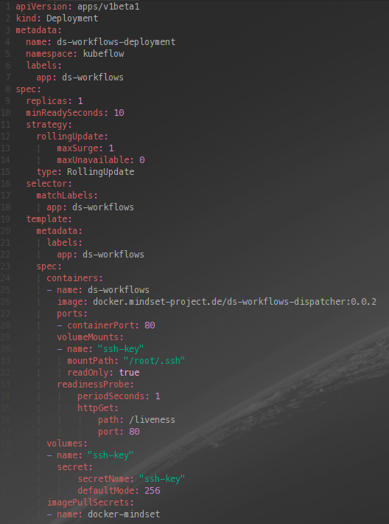
Deployments: Glue it together
A container is a very slim operating system (without visualization and init system)
Containers live in an isolated space on a Host System (in Kubernetes: A Node)
Here: defined and built via Docker

Slide 15
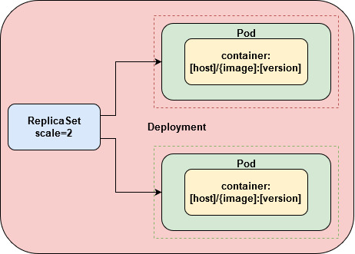
Deployments: Glue it together

Slide 16
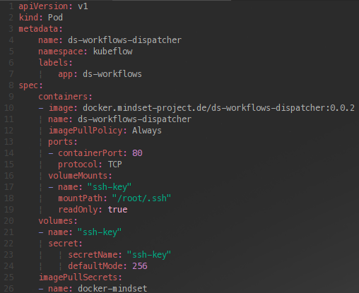
Volumes and Secrets: Persistency.
A container is a very slim operating system (without visualization and init system)
Containers live in an isolated space on a Host System (in Kubernetes: A Node)
Here: defined and built via Docker

Slide 17
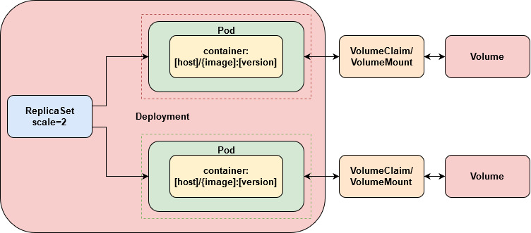
Volumes and Secrets: Persistency.

Slide 18
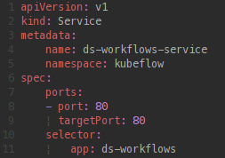
Services: Getting things visible
A container is a very slim operating system (without visualization and init system)
Containers live in an isolated space on a Host System (in Kubernetes: A Node)
Here: defined and built via Docker

Slide 19
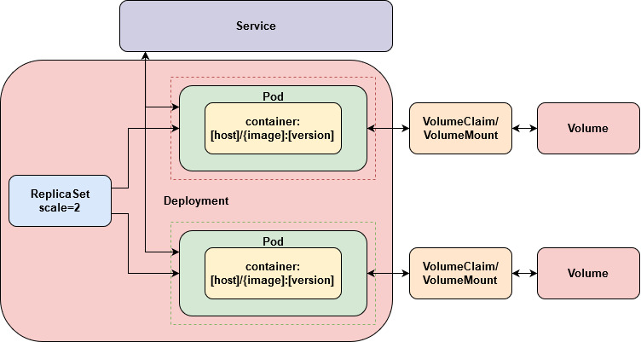
Services: Getting things visible

Slide 20
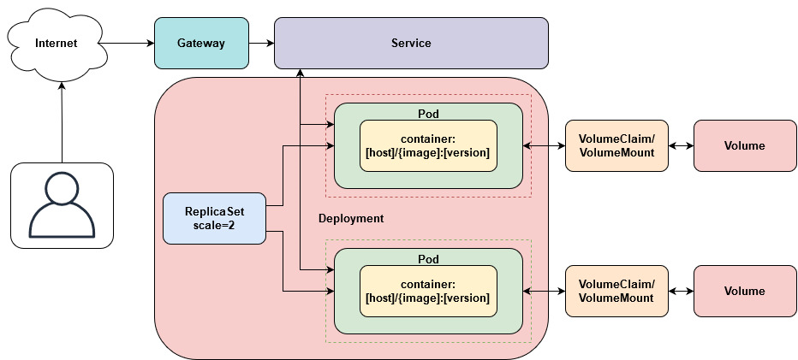
The whole system as an example

Slide 21
Kubernetes and Machine Learning

Slide 22
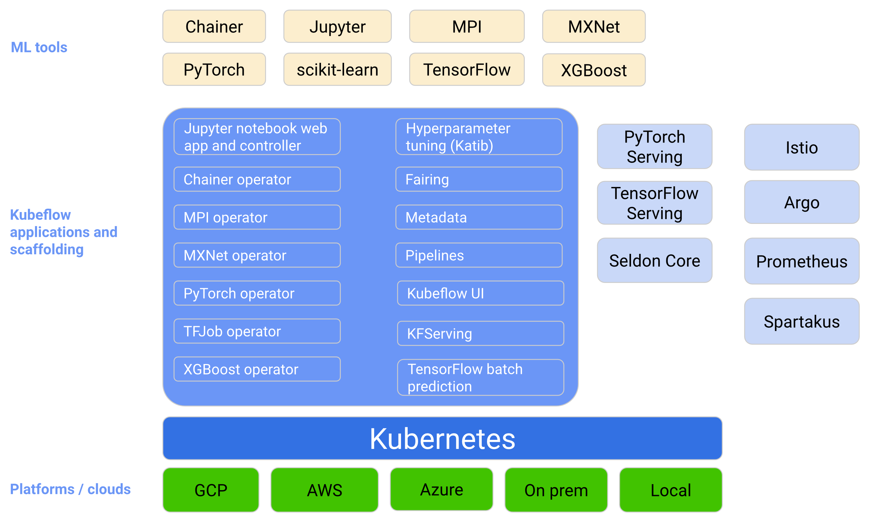
Kubeflow: Getting ML to a cluster
Kubeflow is a framework of tools that is fully compatible with Kubernetes
With Kubeflow we can:
Tune a models hyperparameters
Finding matching model architectures
Define Pipelines that perform our computational heavy-lifting
Deploy our models

Slide 23
Prerequisites
In this section we will see how to use Kubeflow‘s most useful features from within an automated Pipeline (which we will define).
For that purpose we need:
A Kubernetes cluster with Kubeflow up and running
A host running jupyer lab, docker and Python3.8
The Kubeflow pipelines SDK
Kubectl (if our host is local)
Various other Python packages (we‘ll se in the Notebook)
A remote for storing data
The actual data that we want to build a model for (Here: The Sklearn MNIST dataset)

Slide 24
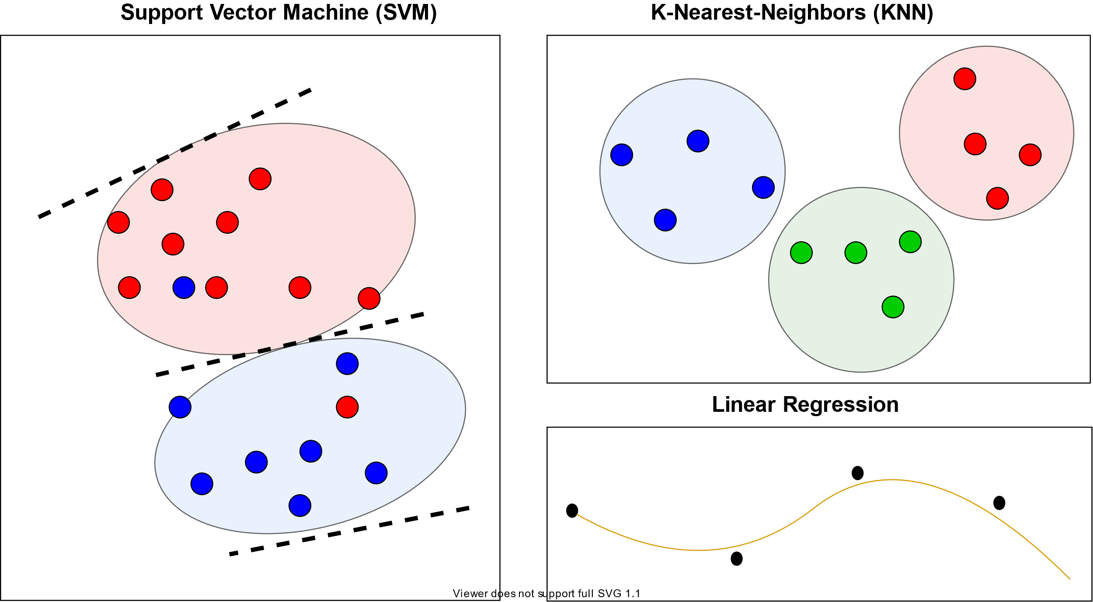
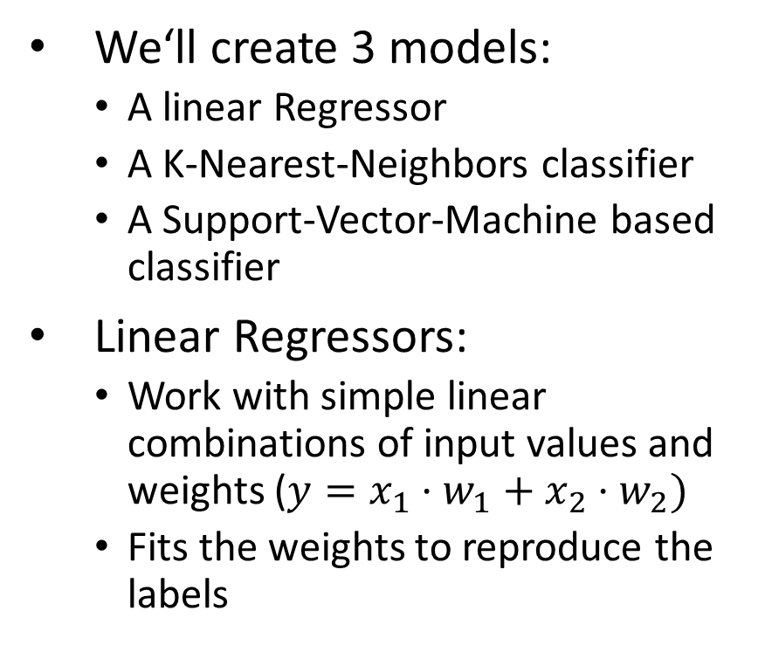
Training the model: Concept
We‘ll create 3 models:
A linear Regressor
A K-Nearest-Neighbors classifier
A Support-Vector-Machine based classifier
Linear Regressors:
Work with simple linear combinations of input values and weights ($y=x_{1}⋅w_{1}+x_{2}⋅w_{2})$
Fits the weights to reproduce the labels

Slide 25
Training the model: Concept
We‘ll create 3 models:
A linear Regressor
A K-Nearest-Neighbors classifier
A Support-Vector-Machine based classifier
K-Nearest-Neighbors (KNN) Classifiers:
Try to build clusters in each dimension of the data
Build circles around the center of mass of the clusters for classification
Act very stable on various types of data

Slide 26
Training the model: Concept
We‘ll create 3 models:
A linear Regressor
A K-Nearest-Neighbors classifier
A Support-Vector-Machine based classifier
Support-Vector Machines (SVM):
Try to split up a data space be separating lines
„Lines“ (depending on the kernel used) may also define more complex shapes (like circles)
Can be used for classification

Slide 27
Hyperparameter Tuning: Concept
Hyperparameters are such parameters that we can not optimize iteratively (e.g. using a gradient decent)
Typically models (and thus their accuracy) are super sensitive to those
In order to achieve the best possible results we need to select the right hyperparameters
Hyperparameter Tuning can require a remarkable amount of experience

Slide 28
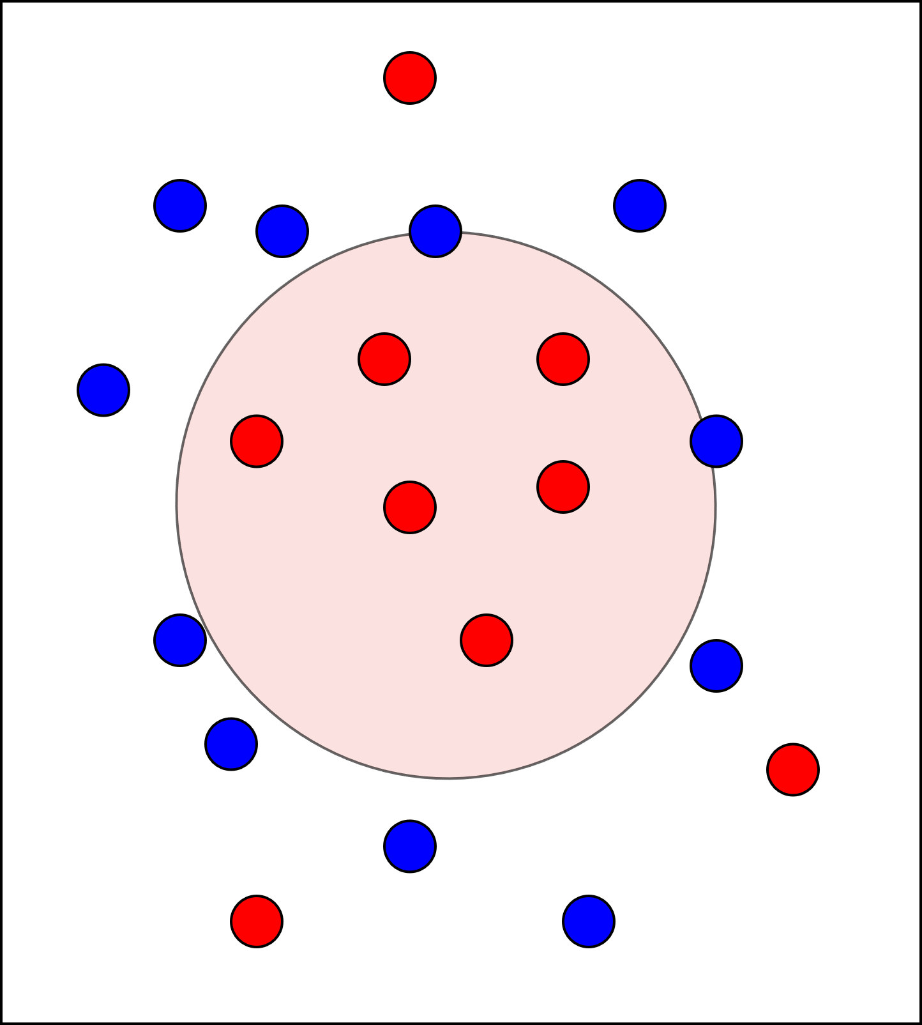
Hyperparameter Tuning: Example 1 – (One-Class) SVM
Goal: separating space to classify the red dots
Hyperparameter: Gamma, will define how close each point needs to be to the created border
Problem: To low gamma may lead to miss points, to high gamma may lead to False Positives (FP)

Slide 29
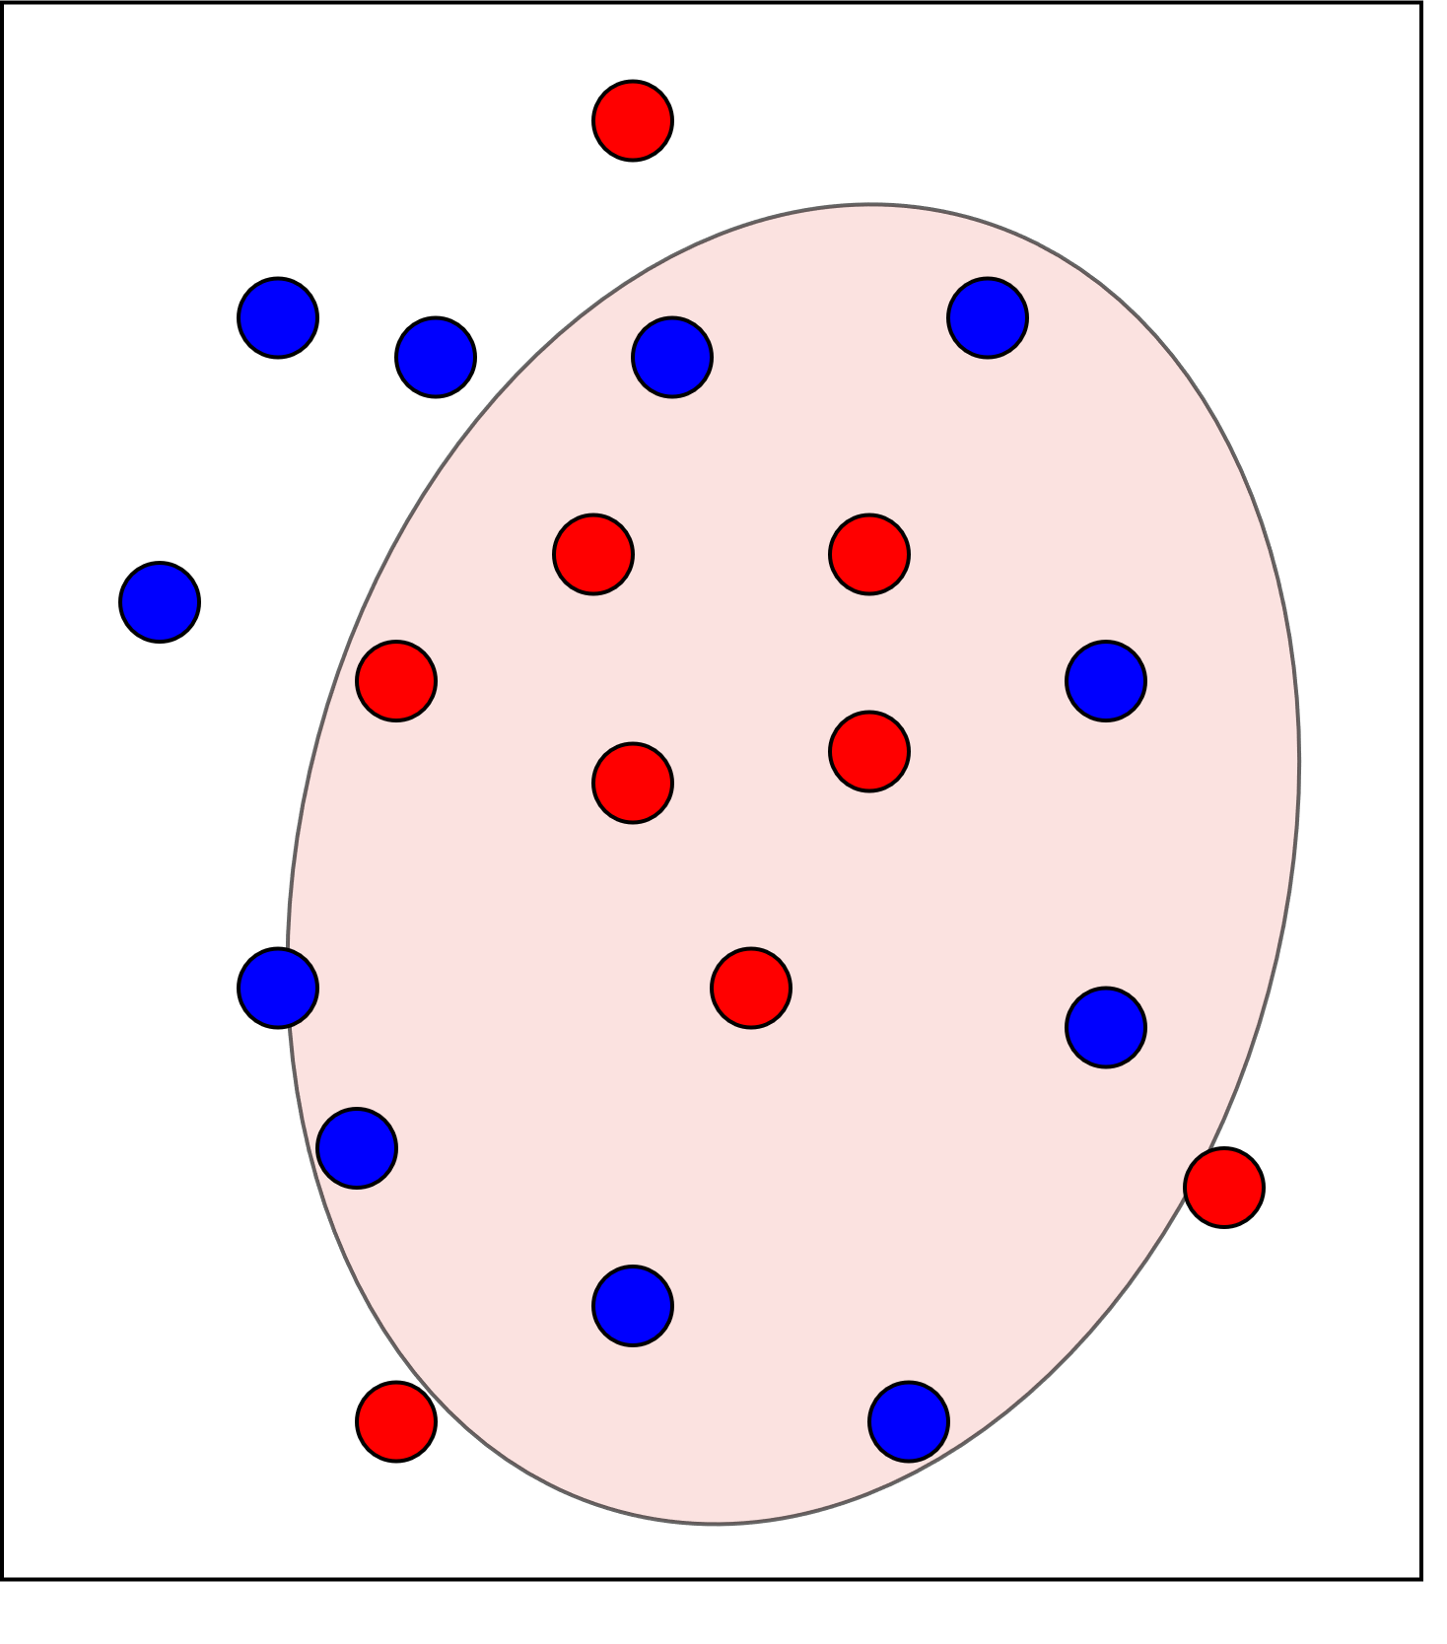
Hyperparameter Tuning: Example 1 – (One-Class) SVM
Goal: separating space to classify the red dots
Hyperparameter: Gamma, will define how close each point needs to be to the created border
Problem: To low gamma may lead to miss points, to high gamma may lead to False Positives (FP)

Slide 30
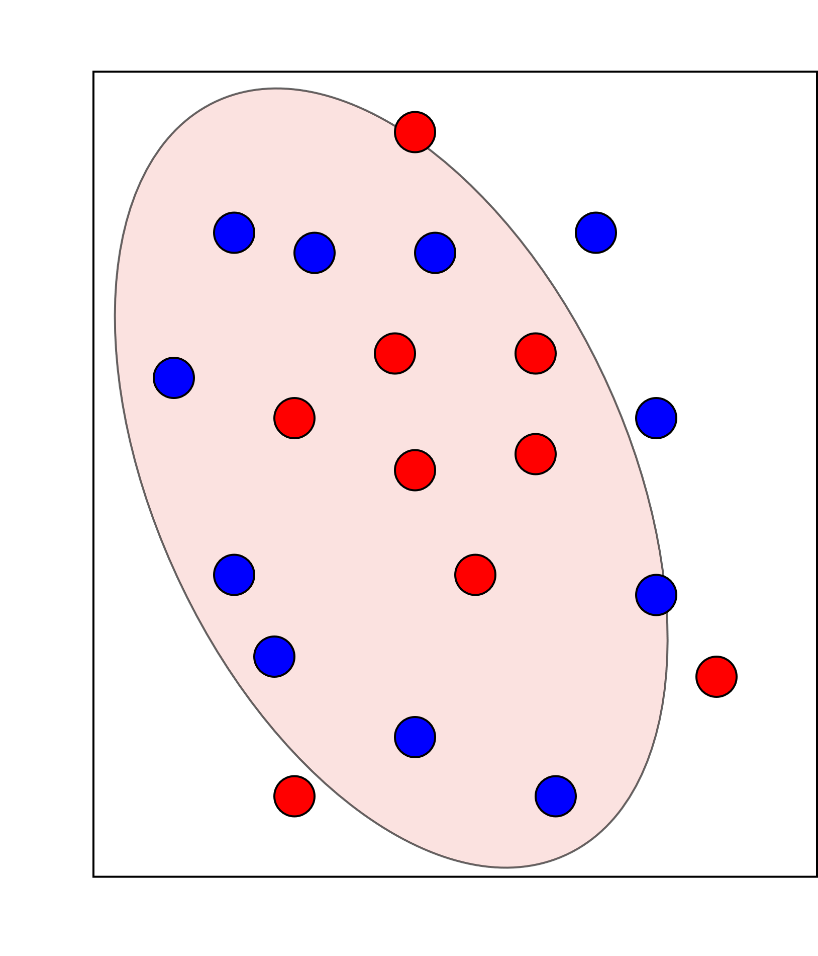
Hyperparameter Tuning: Example 1 – (One-Class) SVM
Goal: separating space to classify the red dots
Hyperparameter: Gamma, will define how close each point needs to be to the created border
Problem: To low gamma may lead to miss points, to high gamma may lead to False Positives (FP)

Slide 31
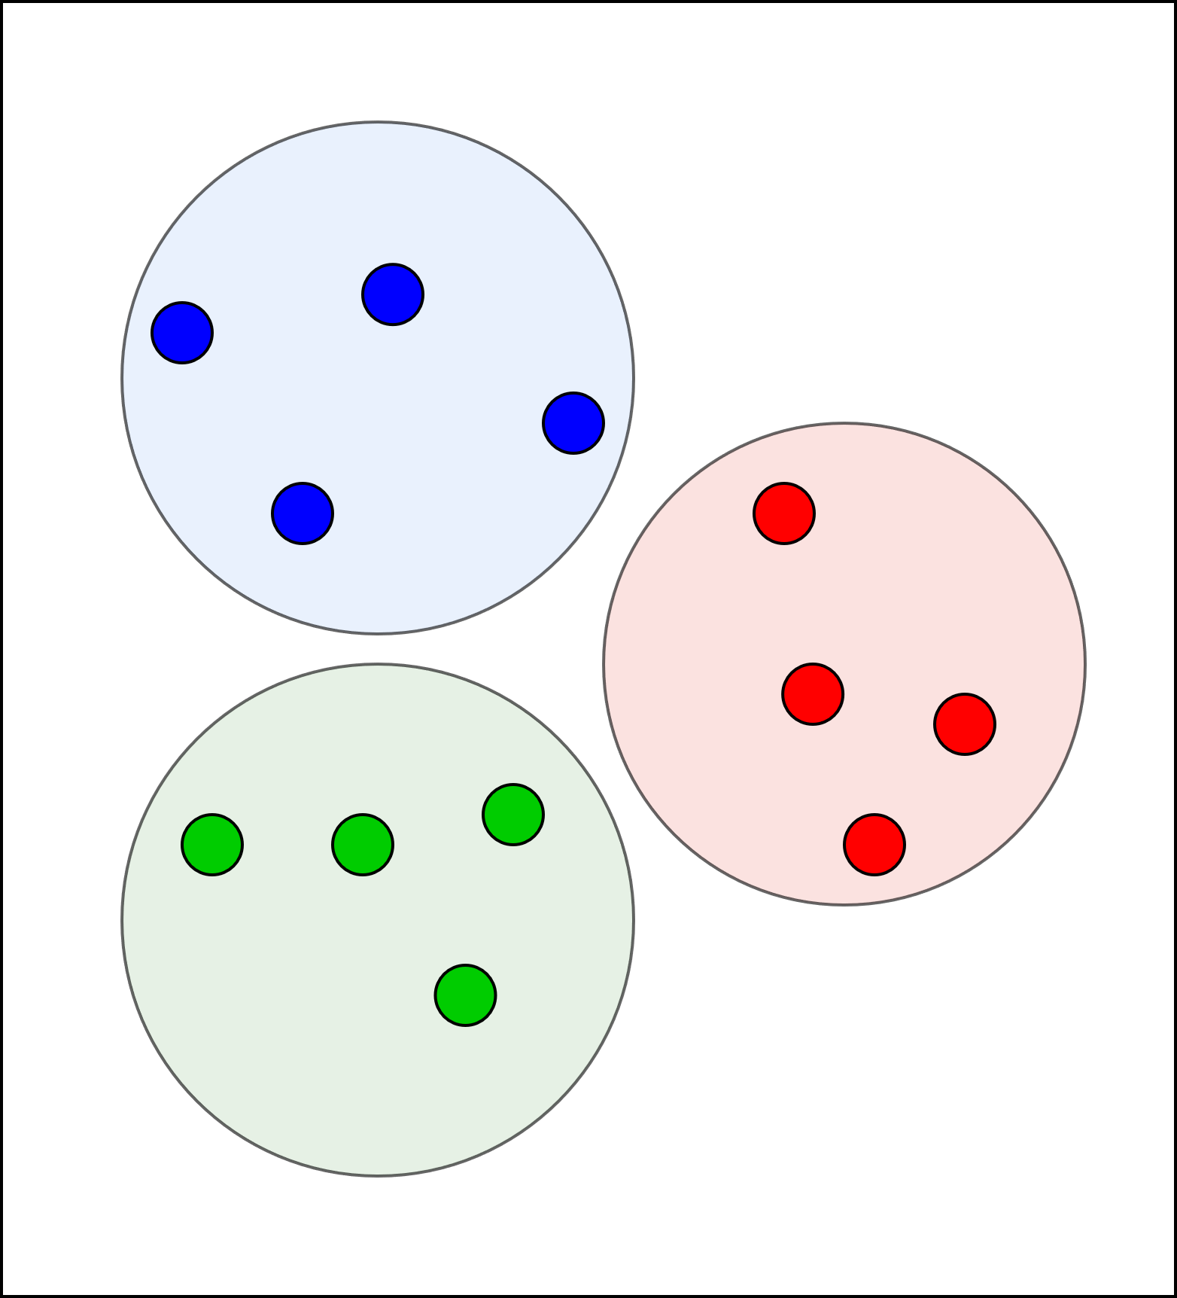
Hyperparameter Tuning: Example 2 – KNN
Goal: Classify red green and blue dots based on their neighborhood
Hyperparameter: K, the amount of neighbors to calculate the center of mass
Problem: Choosing K to low will result in heavy overfitting, but choosing to high will yield high uncertainty

Slide 32
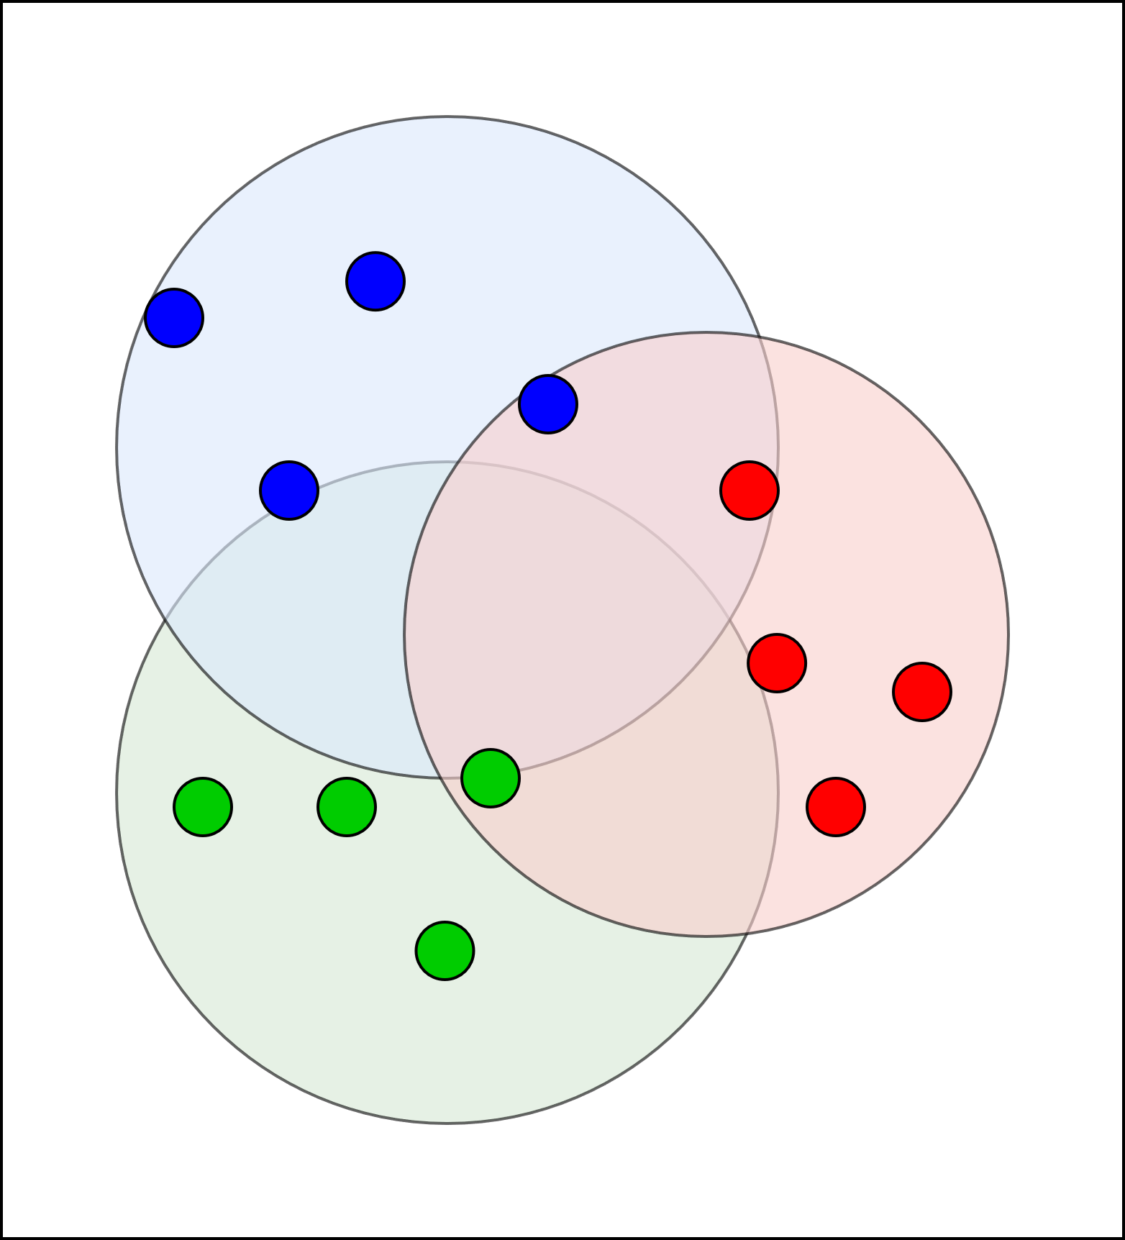
Hyperparameter Tuning: Example 2 – KNN
Goal: Classify red green and blue dots based on their neighborhood
Hyperparameter: K, the amount of neighbors to calculate the center of mass
Problem: Choosing K to low will result in heavy overfitting, but choosing to high will yield high uncertainty

Slide 33
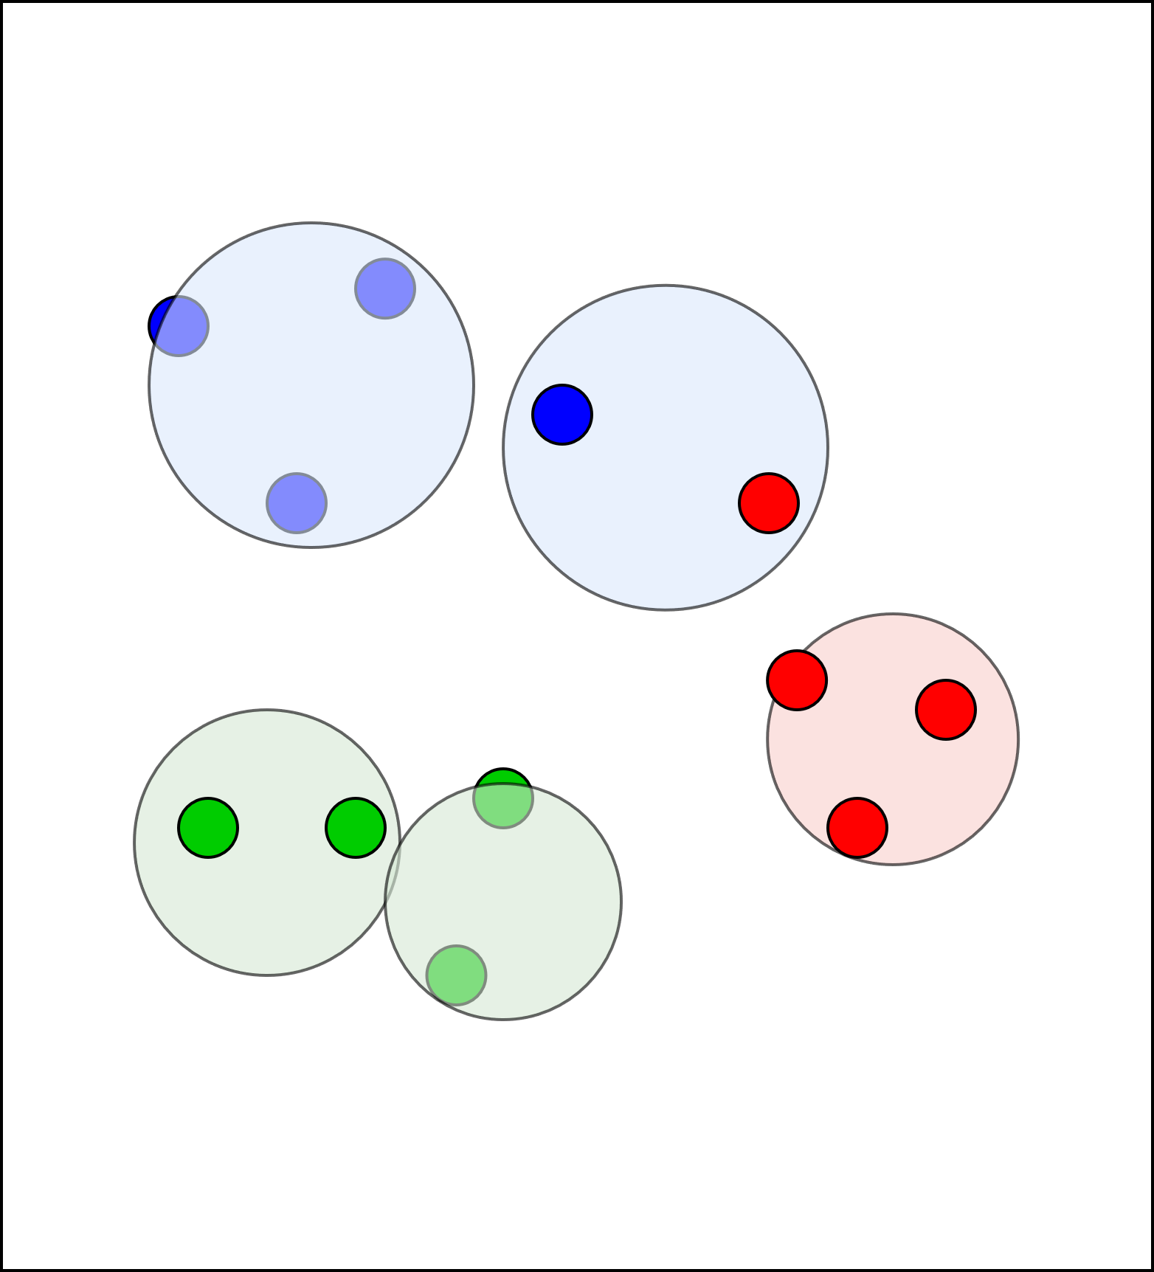
Hyperparameter Tuning: Example 2 – KNN
Goal: Classify red green and blue dots based on their neighborhood
Hyperparameter: K, the amount of neighbors to calculate the center of mass
Problem: Choosing K to low will result in heavy overfitting, but choosing to high will yield high uncertainty

Slide 34
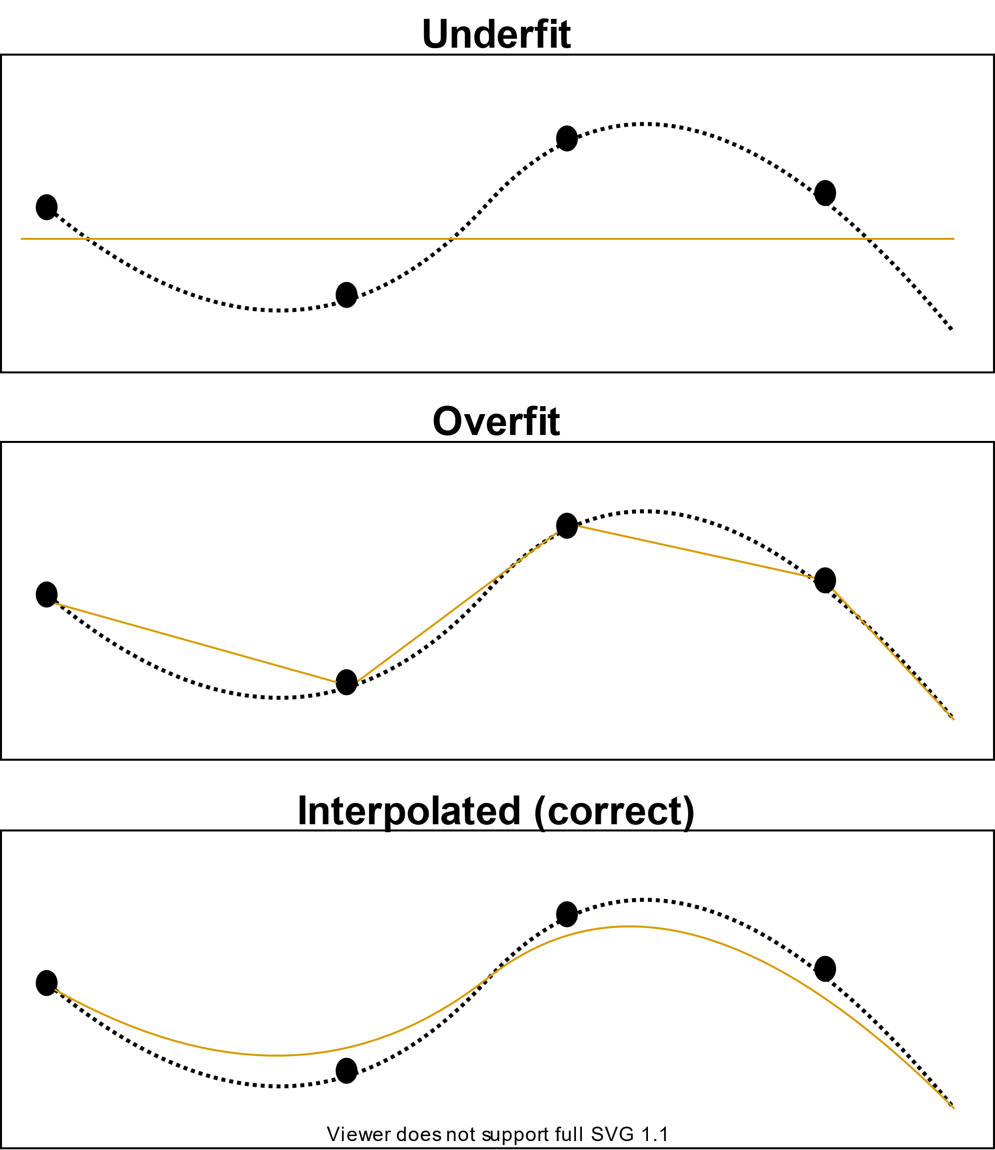
Validation: Concept
Besides training the model we need to validate its performance
Various metrics exist: accuracy, balanced accuracy, koen kappa, F-score….
Goal: Avoid overfitting
Good practice: Cross Validation (CV)
If feasible: Separate test and validation dataset (because of hyperparameter‘s influence)

Slide 35
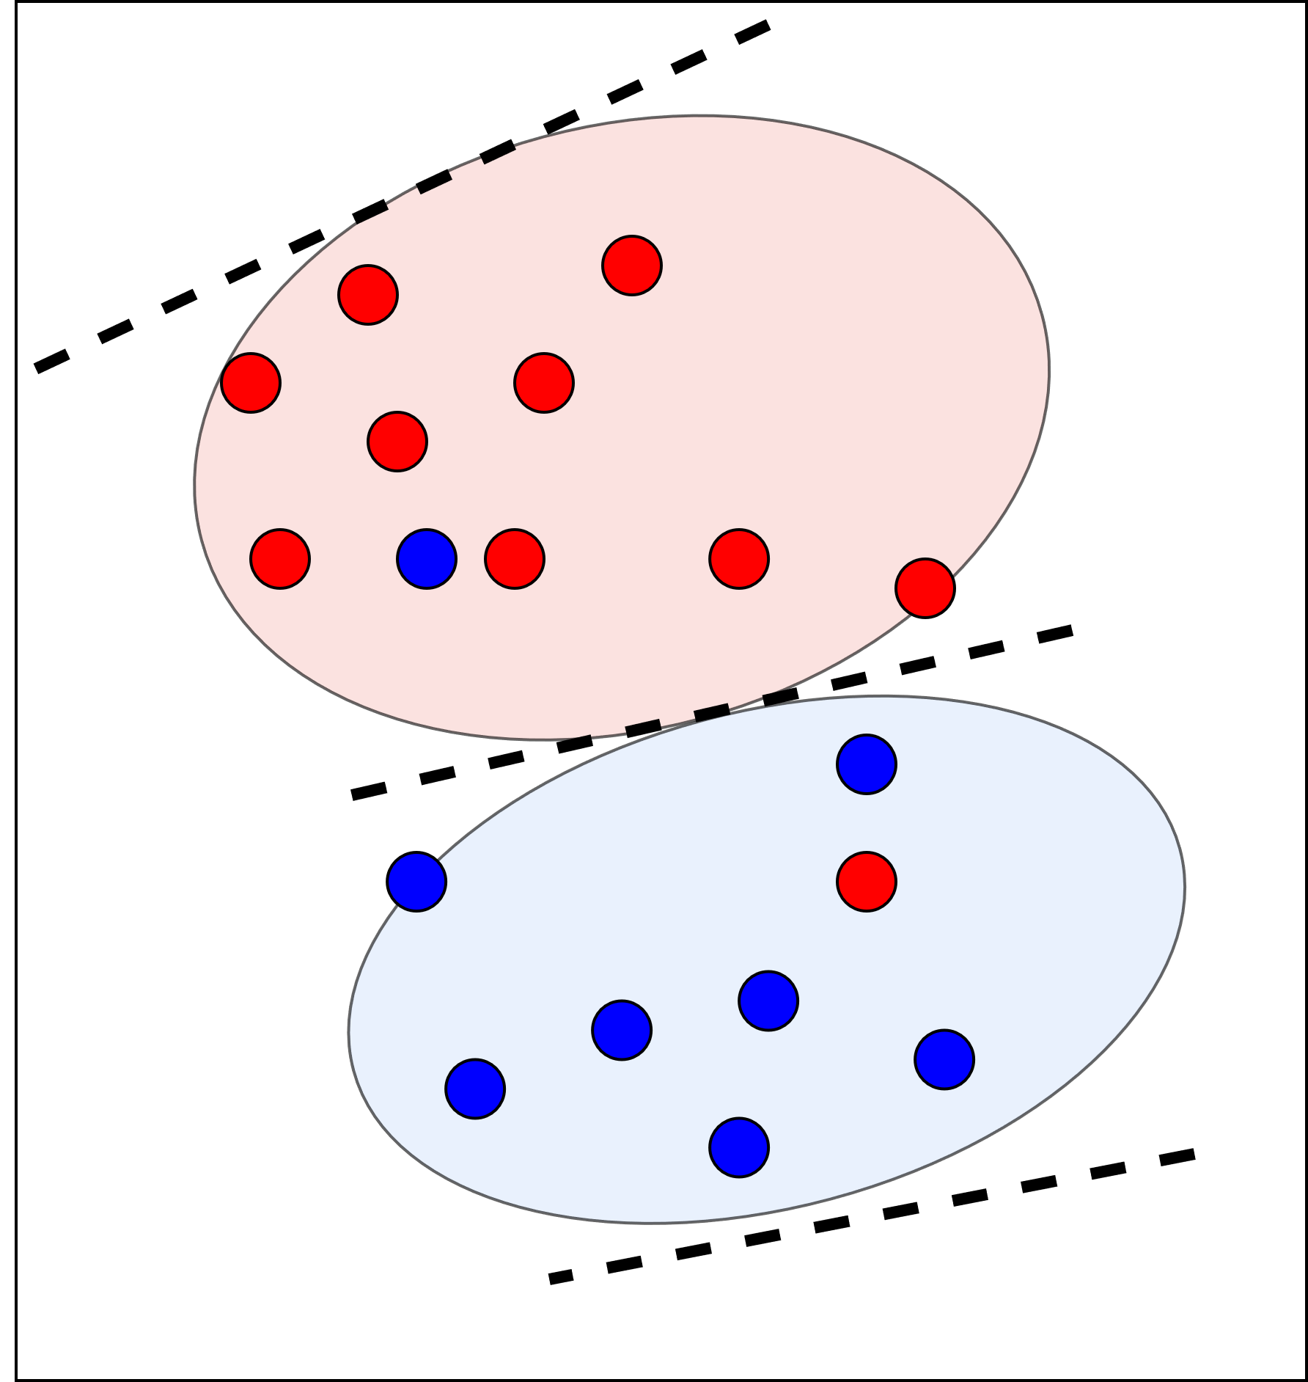
Validation: CV Example 1 - SVM
Goal: Classifying blue and red dots with a SVM
Assumption: Model was trained using training data similar to the test data in the image
First situation: We splitted our data 1:4 (25% test data)
Accuracy ((FP+FN)/N): ~89%

Slide 36
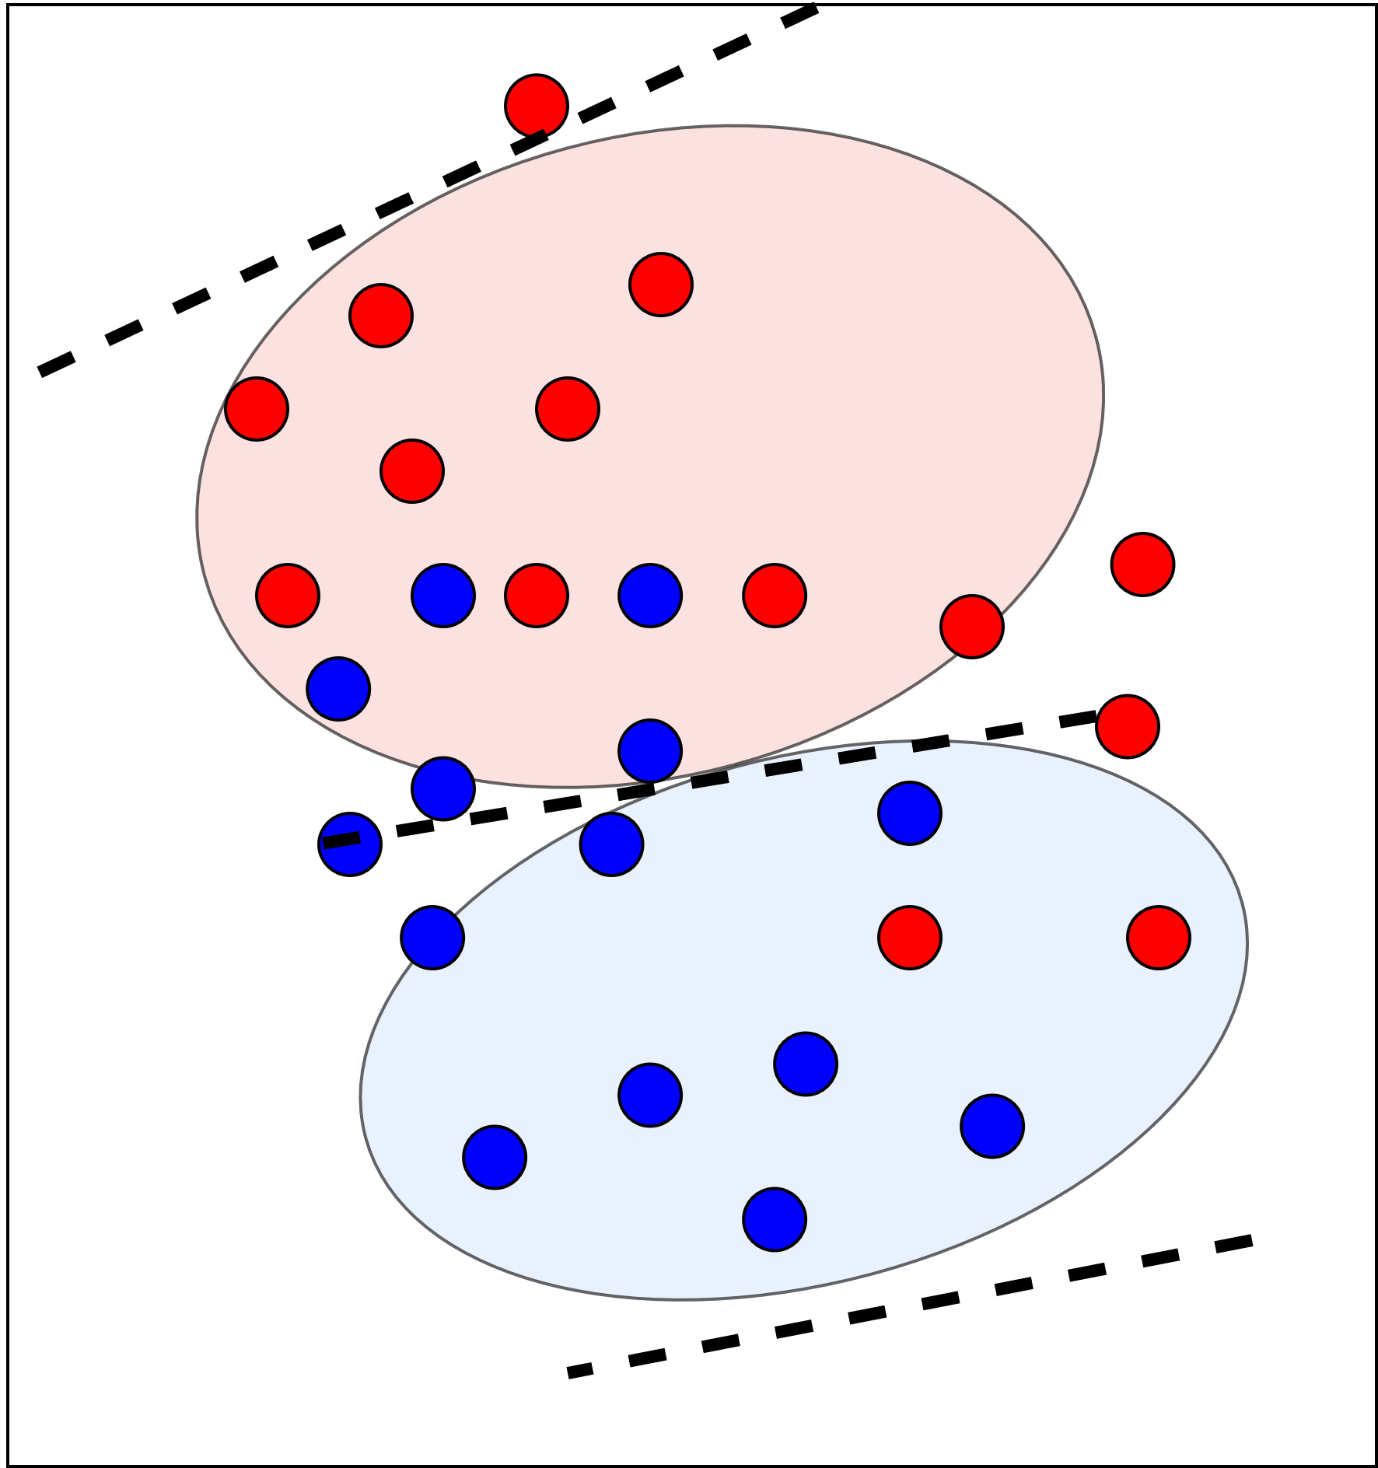
Validation: CV Example - SVM
After a while new data has been collected
Point do not match assumed space
Accuracy drops to ~71%
Question: Could we have estimated this drop?

Slide 37
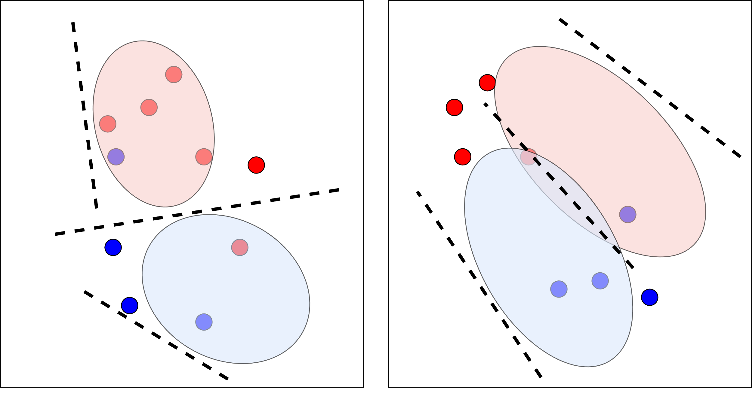
Validation: CV Example 1 - SVM
Answer: Yes!
Method: Splitting our data into multiple training and test sets (folds)
In the image: the marked space is caused by training on the given data fold (testing is done with the points)
Left: worst case
Right: best case
Result: Mean accuracy of ~71%

Slide 38
Deployment
After training our model and checking everything is fine we need to rollout an AI-service to make it accessible
Challenge: Models need to be retrained continously and thus deployment needs to be cyclic
Problem: Rolling out our model manually is time-consuming (and boring)
Solution: Kubeflow offers various methods to automatically serve a model via GrPC or REST

Slide 39
Putting things together
Data Versioning and convenience Code

Slide 40
What more could we need?
Kubeflow is great for automating a reproducible standard ML-approach
Daily Business brings other challenges:
Versioning the Code that we write to define our model etc.
Versioning the Data that we used revision-wise
Rolling back our model if unexpected behaviour occurs
To tackle those issues we will integrate the pipeline with python DVC and Git in a more complex Deep Learning scenario (also using the MNIST dataset)

Slide 41
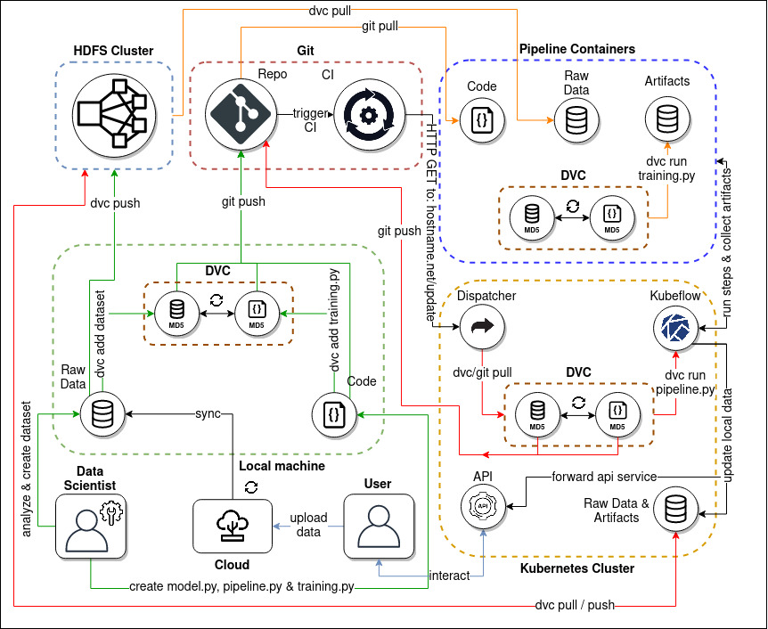
Overview: The whole System

Slide 42
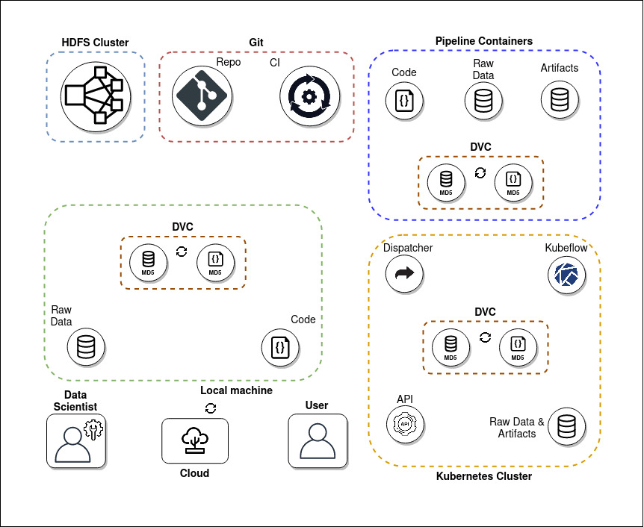

Slide 43
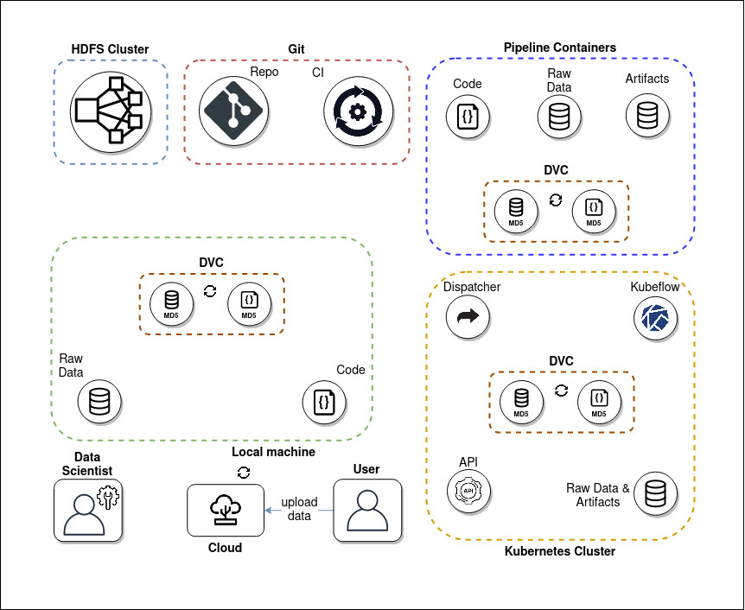
Step 1: User loads up data

Slide 44
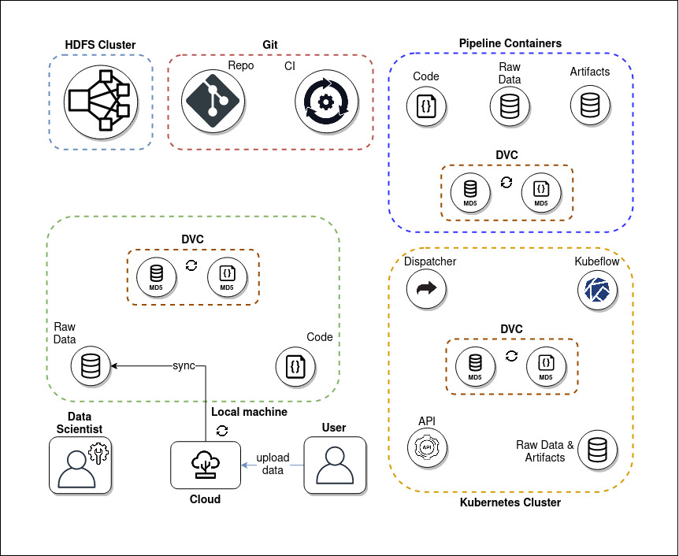
Step 2: data is synced

Slide 45
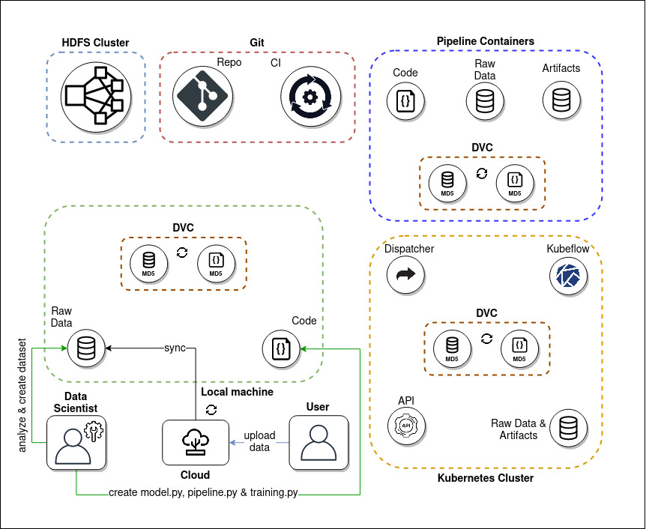
Step 3: data munging + model building

Slide 46
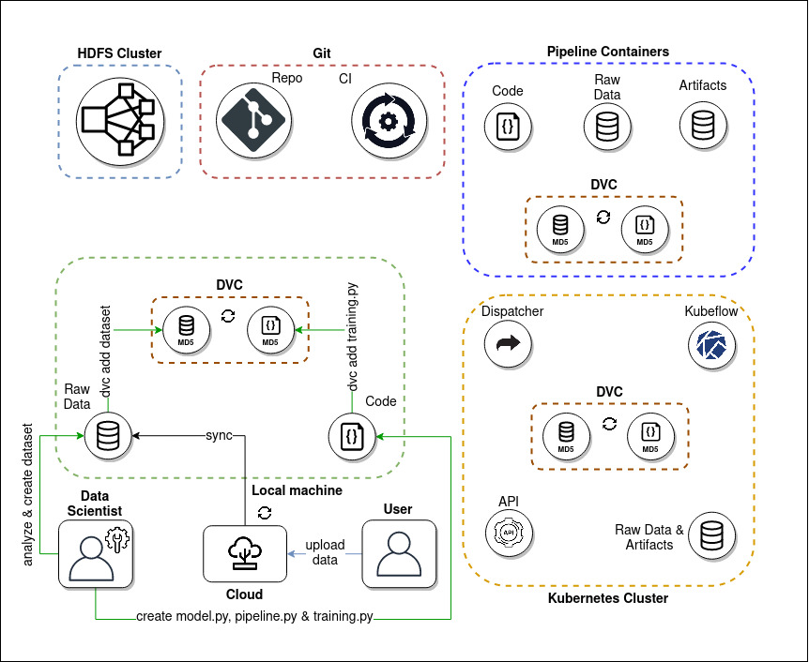
Step 4: create dvc files (hash sums)

Slide 47

Step 5: DVC connects actual data code and hashes

Slide 48
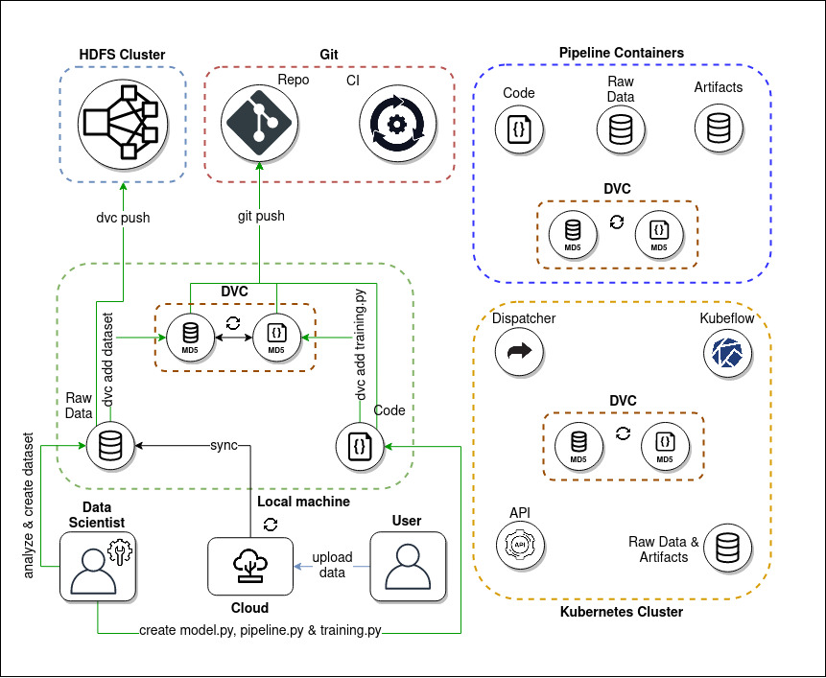
Step 6: Upload data to storage (hdfs) and Code/hashes to Git

Slide 49
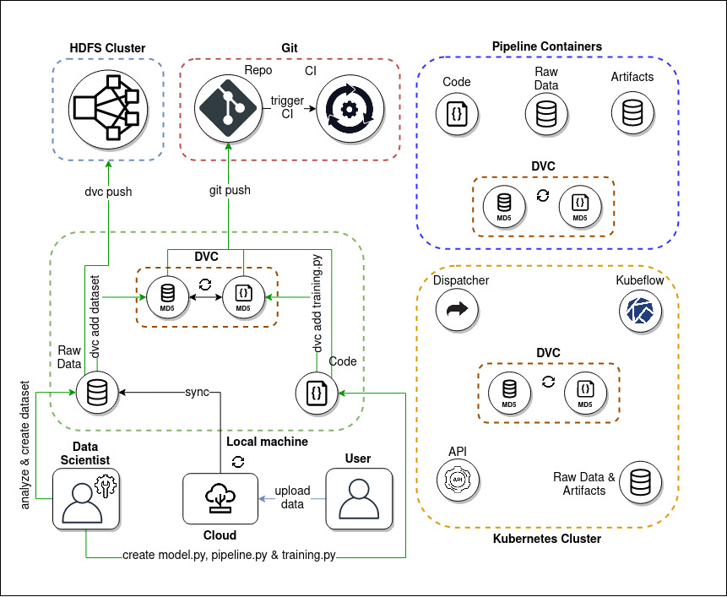
Step 7: Gitlab CI starts

Slide 50
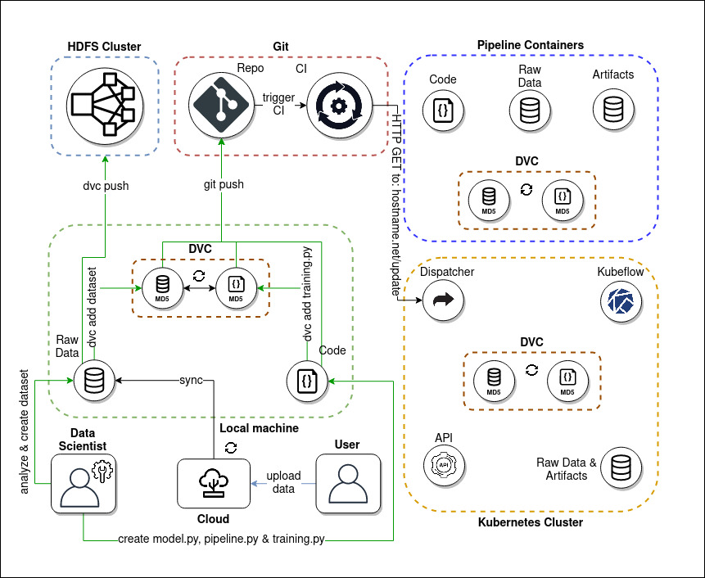
Step 8: Gitlab CI contacts the dispatcher (k8s) service

Slide 51
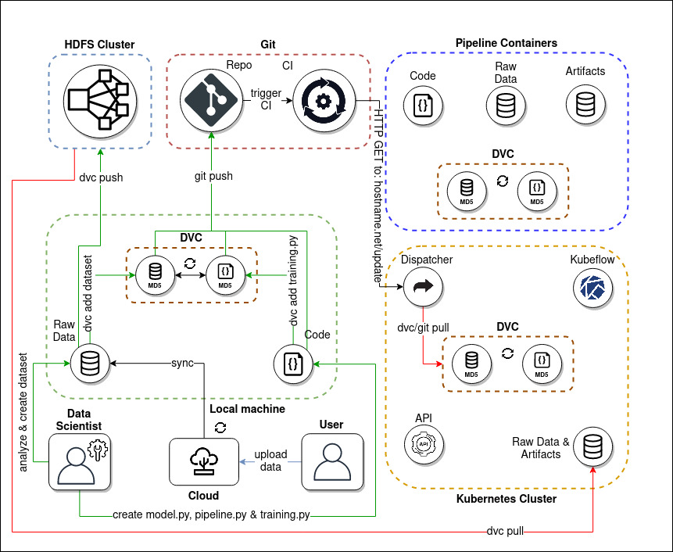
Step 9: dispatcher syncs data, code and hashes

Slide 52
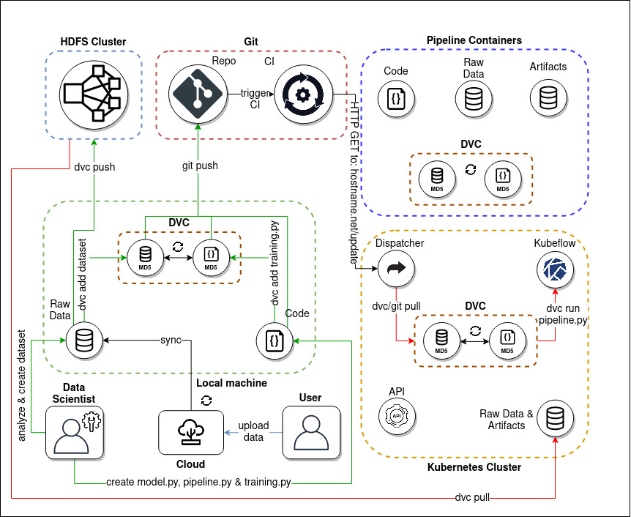
Step 10: Kubeflow pipelines get invoked by DVC

Slide 53
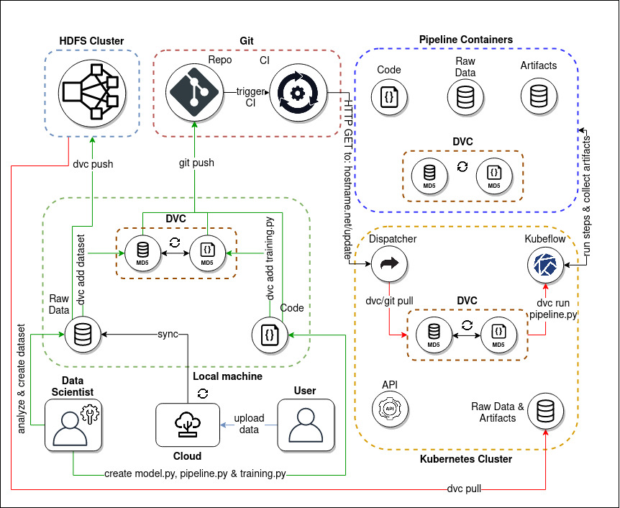
Step 11: Pipeline Pods get started

Slide 54
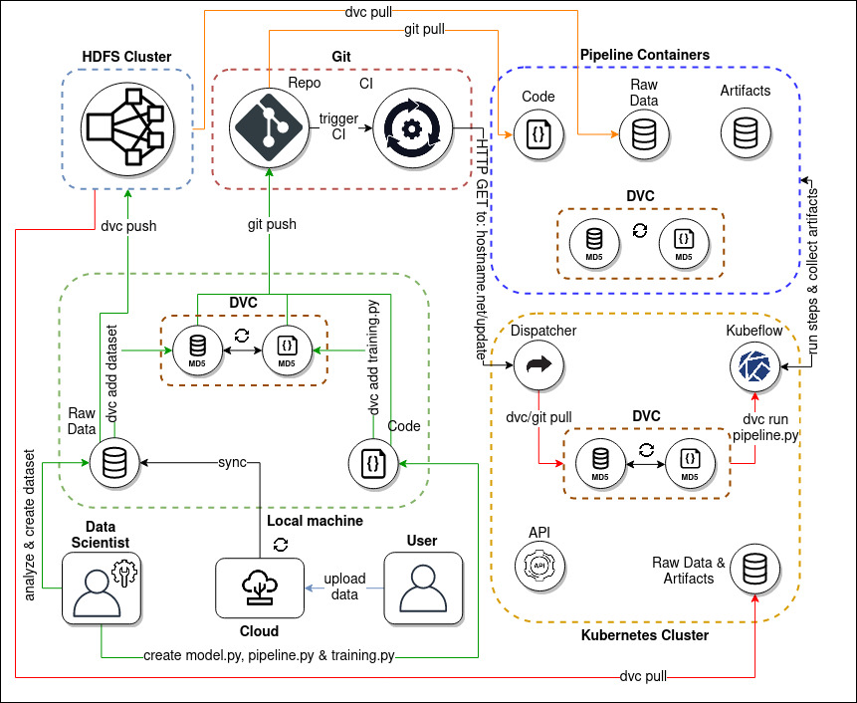
Step 12: Each pod syncs the data

Slide 55
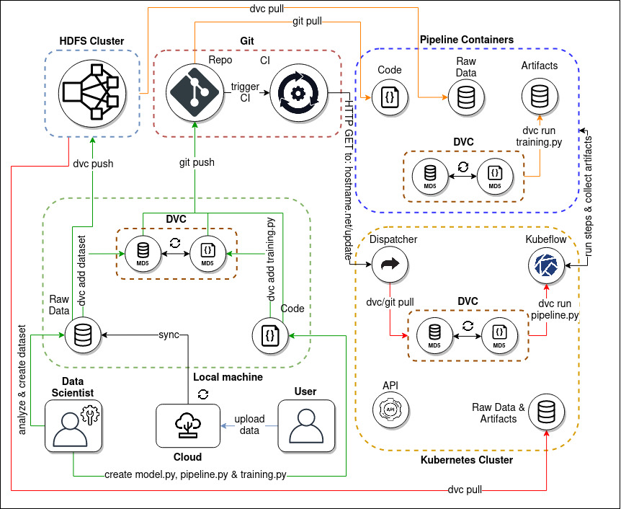
Step 13: Inside each Pod the scripts get excuted (i.P. by DVC)

Slide 56
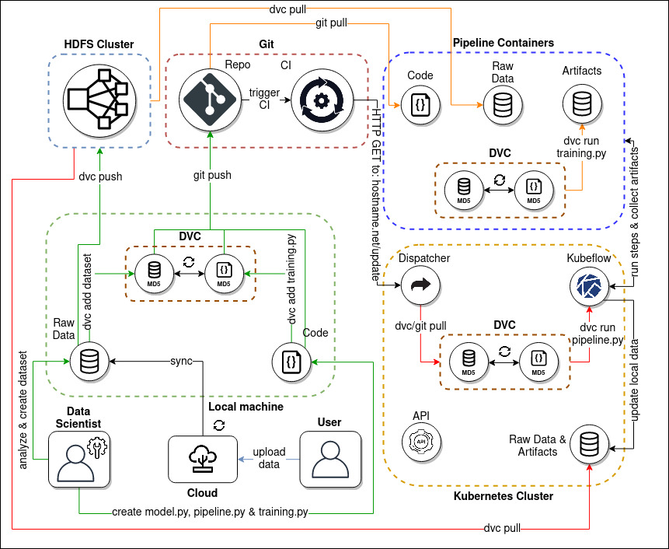
Step 14: Artifacts and hashes are collected

Slide 57
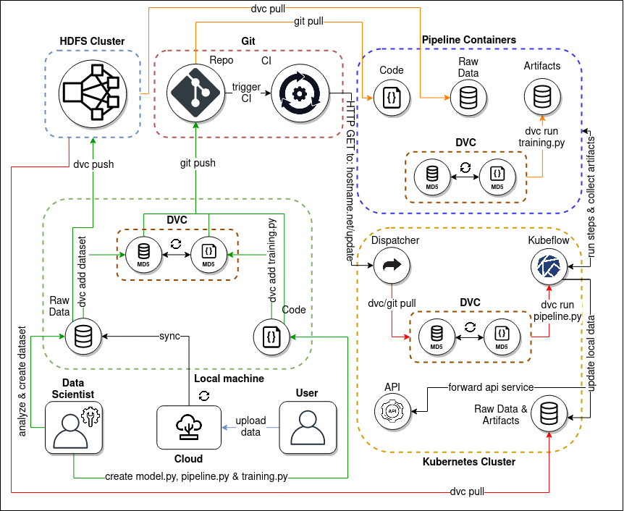
Step 15: API service is hosted

Slide 58

Step 16: artifacts and hashes get pushed to storage / remote

Slide 59
Step 17: a happy user can finally use it‘s service. Yay!

